Slide 1


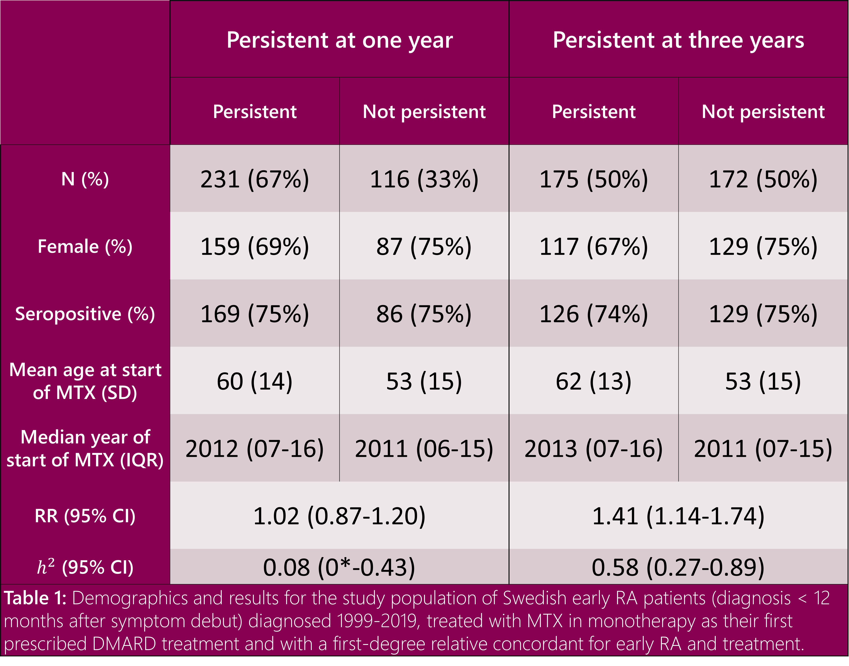
Persistence to methotrexate treatment in early rheumatoid arthritis has a familial component
Long-term persistence to methotrexate in monotherapy aggregates within families of early RA patients
Exploratory analysis:
EULAR response: We further investigated the familiar aggregation of having a EULAR response to MTX in monotherapy at three and six months using logistic regression. Here, we found no evidence of a familial aggregation, neither at three (OR=0.84, 95% CI 0.33-2.09) nor at six months (OR=0.98, 95% CI 0.24-2.29).
Family history: To test the clinical utility of our results we also tested the association of having a family history of persistence with persistence of the index patient using logistic regression. Here too, we found no association of family history with persistence, neither at one (OR=0.91 95% CI 0.42-1.99) nor three years (OR=1.37, 95% CI 0.64-2.95) though sample size was a limitation.
A. Sysojev¹, T. Frisell¹, B. Delcoigne¹,
J. Askling¹ and H. Westerlind¹
¹Clinical Epidemiology Division, Department of Medicine Solna, Karolinska Institutet, Stockholm, Sweden
Background: Methotrexate (MTX) in monotherapy is commonly the first prescribed treatment to patients with rheumatoid arthritis (RA). However, a significant proportion show little to no response to such treatment. We investigated whether remaining on treatment with MTX in DMARD monotherapy aggregates within families and whether there is a genetic component within such a persistence.
Methods: We used data from the nationwide Swedish Rheumatology Quality Register linked to various national registers. Our cohort consisted of early RA patients treated with MTX in monotherapy as their first DMARD and who had a first-degree relative concordant for early RA and treatment. Persistence was measured at both one and three years. Familial aggregation was assessed with log-binomial regression and heritability was estimated via tetrachoric correlations.
Results: Among 16,986 early RA patients treated with MTX in monotherapy, 354 were first-degree relatives. Familial risks and heritability were both small and non-significant at one year and increased but increased and became significant at three years (Table 1).
Conclusion: Persistence to MTX in monotherapy aggregates within families of RA patients and the magnitude of this aggregation increases over time.
 | Persistent at one year |  | Persistent at three years
 | Persistent | Not persistent | Persistent | Not persistent
N (%) | 231 (67%) | 116 (33%) | 175 (50%) | 172 (50%)
Female (%) | 159 (69%) | 87 (75%) | 117 (67%) | 129 (75%)
Seropositive (%) | 169 (75%) | 86 (75%) | 126 (74%) | 129 (75%)
Mean age at start of MTX (SD) | 60 (14) | 53 (15) | 62 (13) | 53 (15)
Median year of start of MTX (IQR) | 2012 (07-16) | 2011 (06-15) | 2013 (07-16) | 2011 (07-15)
RR (95% CI) | 1.02 (0.87-1.20) |  | 1.41 (1.14-1.74)
$h^{2}$ (95% CI) | 0.08 (0*-0.43) |  | 0.58 (0.27-0.89)
Table 1: Demographics and results for the study population of Swedish early RA patients (diagnosis < 12 months after symptom debut) diagnosed 1999-2019, treated with MTX in monotherapy as their first prescribed DMARD treatment and with a first-degree relative concordant for early RA and treatment.
About the presenter:
Anton Sysojev is a PhD candidate at the Clinical Epidemiology Division at Karolinska Institutet. His background is in mathematical statistics and he’s currently working in Johan Askling’s group on topics related to comorbidities and methotrexate treatment within RA. His next project will investigate genetic variants associated with persistence to MTX in monotherapy and the SNP-based heritability.
+46739651247
anton.oberg.sysojev@ki.se

